Slide 1

Cohort Studies

Slide 2
Cohort Study
Also known as
Prospective study
Longitudinal Study
Incidence study
Forward-looking study
Features
The cohorts are identified prior to the appearance of the disease under investigation
The study groups, so defined, are observed over a period of time to determine the frequency of disease among them
The study proceeds forward from cause to effect.

Slide 3
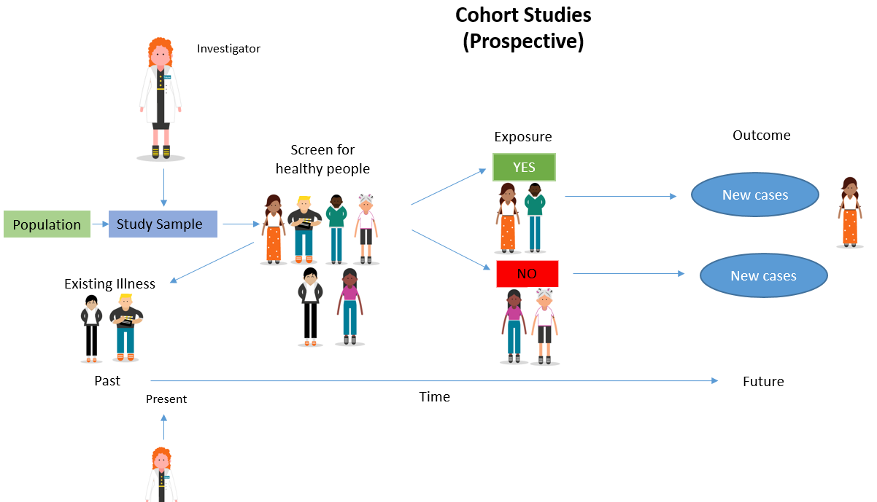

Slide 4
Cohort
“cohort” is defined as a group of people who share a common characteristic or experience within a defined time period (e.g., age, occupation, exposure to a drug or vaccine, pregnancy, insured persons, etc).
Group of people born on the same day or in the same period of time (usually a year) form a “birth cohort”.
Persons exposed to a common drug, vaccine or infection within a defined period constitute an “exposure cohort”.
A group of males or females married on the same day or in the same period of time form a“marriage cohort”.
A cohort might be all those who survived a myocardial infarction in one particular year.
The comparison group may be the general population from which the cohort is drawn, or it may be another cohort of persons thought to have had little or no exposure to the substance in question, but otherwise similar.

Slide 5
Indication for cohort studies
When there is good evidence of an association between exposure and disease as derived from clinical observations and supported by descriptive and case control studies
When exposure is rare, but the incidence of disease high among exposed, e.g., special exposure groups like those in industries, exposure to X-rays, etc
When attrition of study population can be minimized, e.g., follow-up is easy, cohort is stable, cooperative and easily accessible,
When ample funds are available.

Slide 6
Framework (cause to effect)
Cohort | Disease (+) | Disease (+) | Total
Exposed to putative aetiologic factor | a | b | a + b
Non-Exposed to putative aetiologic factor | c | d | c + d

Slide 7
General consideration
The cohorts must be free from the disease under study.
As the knowledge of the disease permits, both the groups (i.e., study and control cohorts) should be equally susceptible to the disease under study, or efficiently reflect any difference in disease occurrence
Both the groups should be comparable in respect of all the possible variables, which may influence the frequency of the disease
The diagnostic and eligibility criteria of the disease must be defined beforehand; this will depend upon the availability of reliable methods for recognizing the disease when it develops.

Slide 8
Types of cohort studies
Prospective cohort studies
A prospective cohort study (or “current” cohort study) is one in which the outcome (e.g., disease) has not yet occurred at the time the investigation begins.
Most prospective studies begin in the present and continue into future.
The long-term effects of exposure to uranium was evaluated by identifying a group of uranium miners and a comparison group of individuals not exposed to uranium mining and by assessing subsequent development of lung cancer in both the groups. The principal finding was that the uranium miners had an excess frequency of lung cancer compared to non-miners.
The US Public Health Service’s Framingham Heart Study, Doll and Hills prospective study on smoking and lung cancer, and study of oral contraceptives and health by the Royal College of General Practitioners are examples of this type of study.

Slide 9
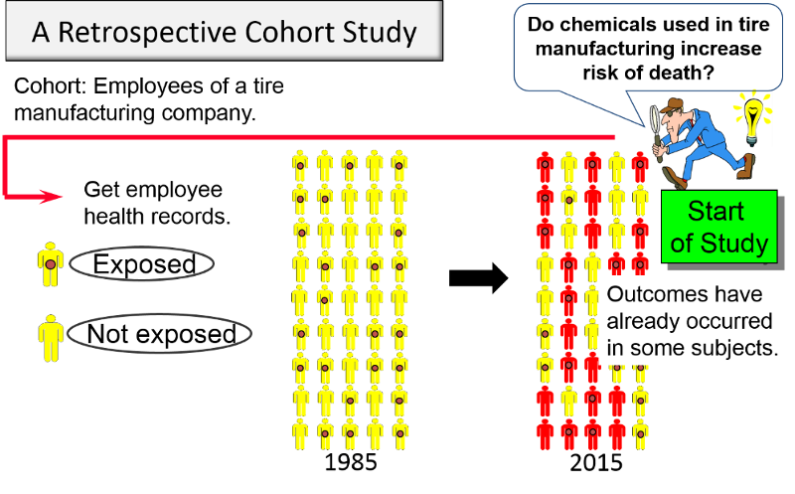
Retrospective cohort studies
Study in which the outcomes have all occurred before the start of the investigation.
The investigator goes back in time, sometimes 10 to 30 years, to select his study groups from existing records of past employment, medical or other records and traces them forward through time, from a past date fixed on the records, usually up to the present.
AKA: retrospective cohort study, “historical” cohort study, prospective study in retrospect and non-concurrent prospective study.
The most notable retrospective cohort studies to date are those of occupational exposures, because the recorded information is easily available.
Retrospective cohort studies are generally more economical and produce results more quickly than prospective cohort studies.

Slide 10
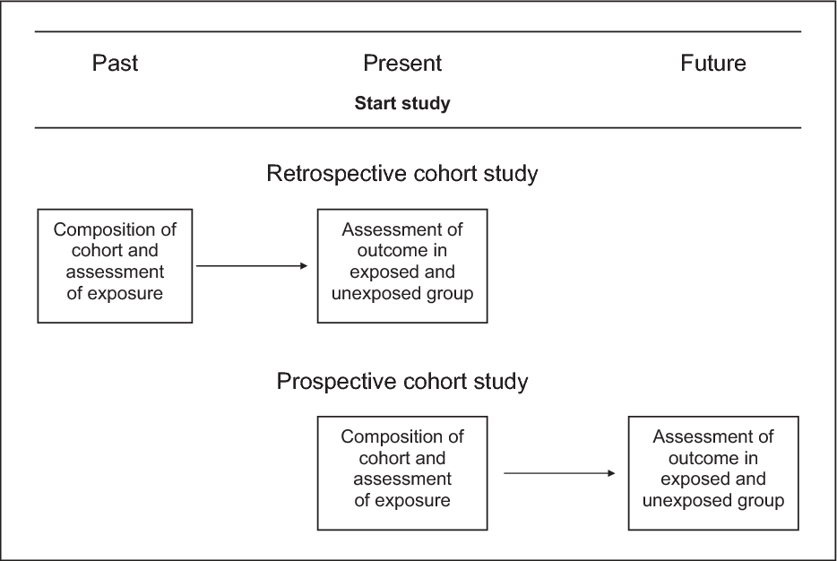
Combination of retrospective and prospective cohort studies

Slide 11
Nested case control study
Variation of a case-control study in which cases and controls are drawn from the population in a fully enumerated cohort.
The exposure of interest is only measured among the cases and the selected controls. Thus, the nested case-control study is more efficient than the full cohort design.
The NCC design is often used when the exposure of interest is difficult or expensive to obtain and when the outcome is rare.
The nested case-control design accommodates case event times into the sampling of controls.
In this design, one or more controls are selected for each case from the risk set at the time at which the case event occurs.
Controls may also be matched to cases on selected variables.
Nested case-control studies are particularly suited for use within large prospective cohorts, when it is desirable to process exposure information only for cases and a subset of non-cases

Slide 12
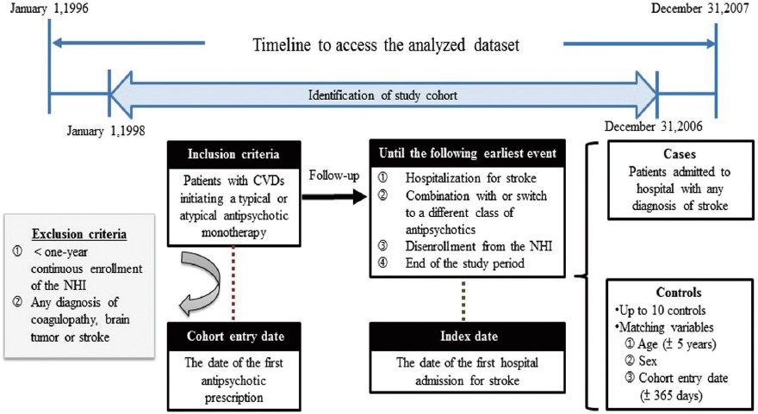

Slide 13
Elements
Selection of study subjects
Obtaining data on exposure
Selection of comparison groups
Follow-up
Analysis.

Slide 14
Elements
Selection of study subjects
Obtaining data on exposure
Selection of comparison groups
Follow-up
Analysis.

Slide 15
Selection of study subjects
General population
Exposure or cause of death is fairly frequent in the population
Residing in well defined geographical, political and administrative areas
If the population is very large, an appropriate sample is taken.
The exposed and unexposed segments of the population to be studied should be representative of the corresponding segments of the general population.

Slide 16
Selection of study subjects (Special groups)
Select group
These may be professional groups (e.g., doctors, nurses, lawyers, teachers, civil servants), insured persons, obstetric population, college alumni, government employees, volunteers, etc.
Doll’s prospective study on smoking and lung cancer was carried out on British doctors listed in the Medical Register of the UK in 1951.
These groups are not only homogeneous, but they also offer advantages of accessibility and easy follow-up for a protracted period
Exposure groups :
If the exposure is rare, a more economical procedure is to select a cohort of persons known to have experienced the exposure.
A readily accessible source of these groups is workers in industries and those employed in high-risk situations (e.g., radiologists exposed to X-rays).
When cohorts have been selected because of special exposure, it facilitates classification of cohort members according to the degree or duration of exposure to the suspected factor for subsequent analytical study.

Slide 17
Data on exposure
Cohort members : through personal interviews or mailed questionnaires.
Review of records: Certain kinds of information (e.g., dose of radiation, kinds of surgery, or details of medical treatment) can be obtained only from medical records,
Medical examination or special tests : Some types of information can be obtained only by medical examination or special tests, e.g., blood pressure, serum cholesterol, ECG.
Environmental surveys : This is the best source for obtaining information on exposure levels of the suspected factor in the environment where the cohort lived or worked.
Classification of cohort members :
According to whether or not they have been exposed to the suspected factor, and
According to the level or degree of exposure, at least in broad classes, in the case of special exposure groups
Basic information about demographic variables which might affect the frequency of disease under investigation, should also be collected. Such information will be required for subsequent analysis.

Slide 18
Comparison groups
Internal comparison
External comparison
When information on degree of exposure is not available, it is necessary to put up an external control, to evaluate the experience of the exposed group, e.g., a cohort of radiologists compared with a cohort of ophthalmologists, etc.
The study and control cohorts should be similar in demographic and possibly important variables other than those under study.

Slide 19
Comparison groups
Comparison with general population rates
If none is available, the mortality experience of the exposed group is compared with the mortality experience of the general population in the same geographic area as the exposed people
Rates for disease occurrence in sub-groups of the control cohort by age, sex, and other variables considered important may be applied to the corresponding sub-groups of the study cohort (exposed cohort) to determine the “expected” values in the absence of exposure.
The ratio of “observed” and “expected” values provides a measure of the effect of the factor under study.
The limiting factors in using general population rates for comparison are :
(i) non-availability of population rates for the outcome required;
(ii) the difficulties of selecting the study and comparison groups which are representative of the exposed and non-exposed segments of the general population.

Slide 20
Follow up
The procedures required comprise :
Periodic medical examination of each member of the Cohort
Reviewing physician and hospital records
Routine surveillance of death records
Mailed questionnaires, telephone calls, periodic home visits - preferably all three on an annual basis.
Of the above, periodic examination of each member of the cohort, yields greater amount of information on the individuals examined, than would the use of any other procedure.
Certain percentage of losses to follow-up are inevitable due to death, change of residence, migration or withdrawal of occupation. These losses may bias the results. It is, therefore, necessary to build into the study design a system for obtaining basic information on outcome for those who cannot be followed up in detail for the full duration of the study.
The safest course recommended is to achieve as close to a 95 per cent follow-up as possible

Slide 21
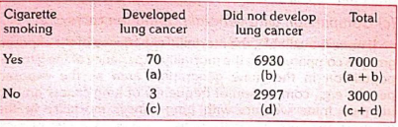
Analysis
Incidence rates of outcome among exposed and non exposed,
Estimation of risk.

Slide 22


Estimation of risk
Relative risk
It is a direct measure (or index) of the “strength” of the association between suspected cause and effect.
It is often useful to consider the 95 per cent confidence interval of a relative risk since it provides an indication of the likely and maximum levels of risk.
Attributable risk aka risk difference
what extent the disease under study can be attributed to the exposure.

Slide 23
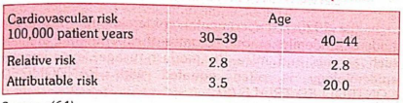
Population attributable risk
Incidence of the disease (or death) in the total population minus the incidence of disease (or death) among those who were not exposed to the suspected causal factor
The concept of population attributable risk is useful in that it provides an estimate of the amount by which the disease could be reduced in that population if the suspected factor was eliminated or modified
Relative risk vs attributable risk

Slide 24
Advantages
Incidence can be calculated,
Several possible outcomes related to exposure can be studied simultaneously
Cohort studies provide a direct estimate of relative risk
Dose response ratios can also be calculated,
Since comparison groups are formed before disease develops, certain forms of bias can be minimized like mis-classification of individuals into exposed and unexposed groups.

Slide 25
Disadvantages
Cohort studies involve a large number of people. They are generally unsuitable for investigating uncommon diseases or diseases with low incidence in the population.
It takes a long time to complete the study and obtain results. It is difficult to keep a large number of individuals under medical surveillance indefinitely.
Certain administrative problems such as loss of experienced staff, loss of funding and extensive record keeping are inevitable
It is not unusual to lose a substantial proportion of the original cohort - they may migrate, lose interest in the study or simply refuse to provide any required information,
Selection of comparison groups which are representative of the exposed and unexposed segments of the population is a limiting factor.
There may be changes in the standard methods or diagnostic criteria of the disease over prolonged follow-up.
Cohort studies are expensive,
The study itself may alter people’s behaviour.
We are faced with ethical problems of varying importance. As evidence accumulates about the implicating factor in the aetiology of disease, we are obliged to intervene and if possible reduce or eliminate this factor
Practical considerations dictate that we must concentrate on a limited number or factors possibly related to disease outcome.

Slide 26
Bias
Selection bias
Information bias
Confusion bias

Slide 27
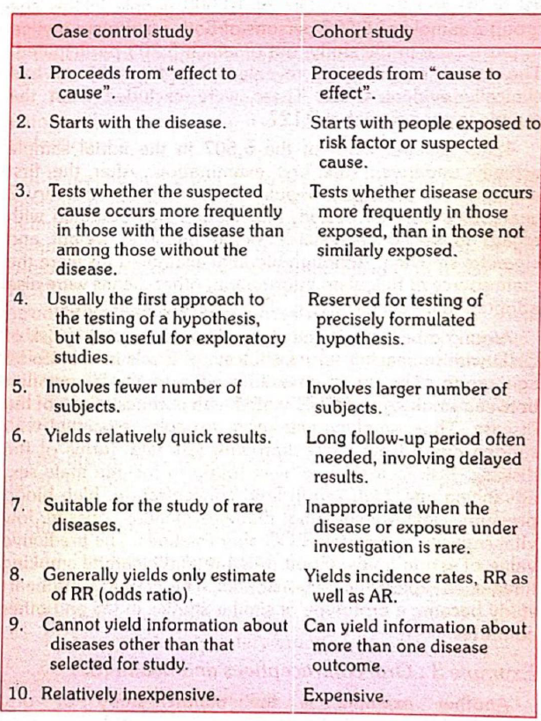

Slide 28

Thanks

